Slide 1
Virtualization VS Containerization

Slide 2
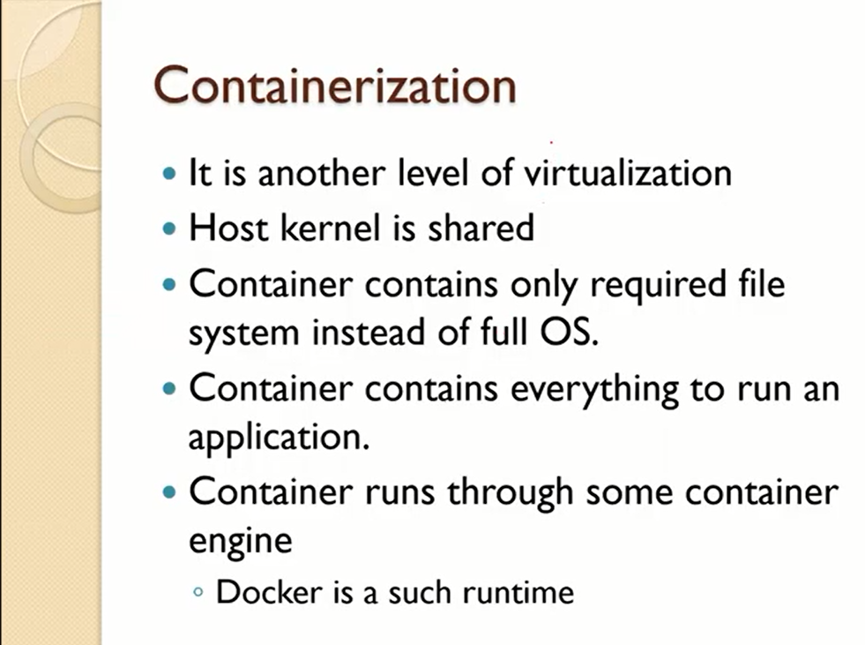

Slide 3
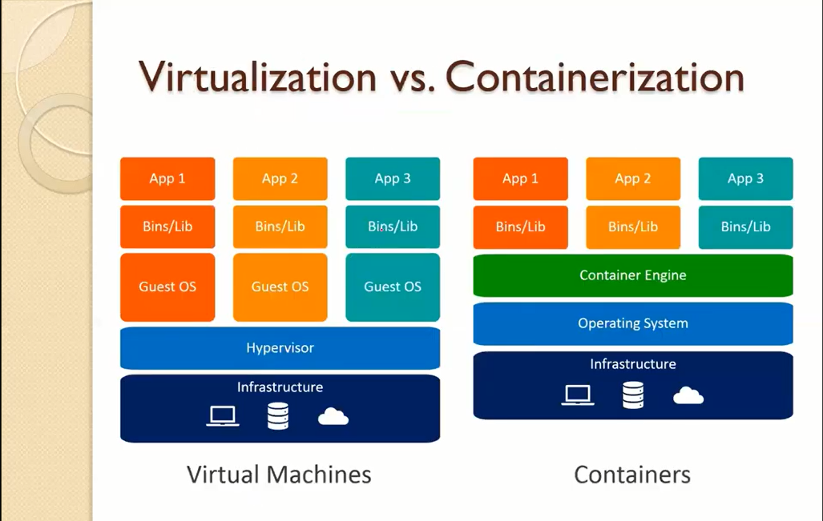

Slide 4
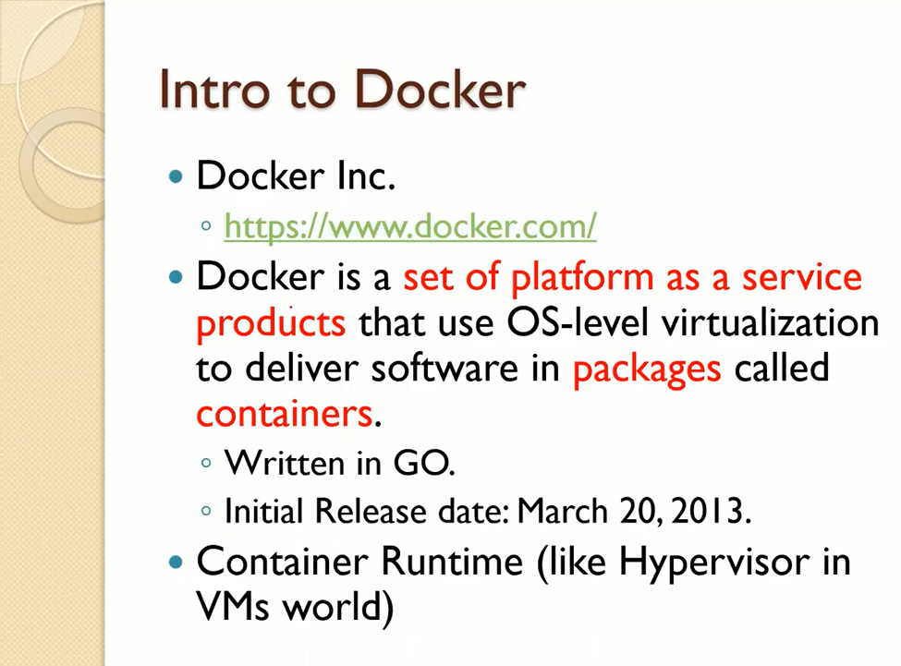

Slide 5
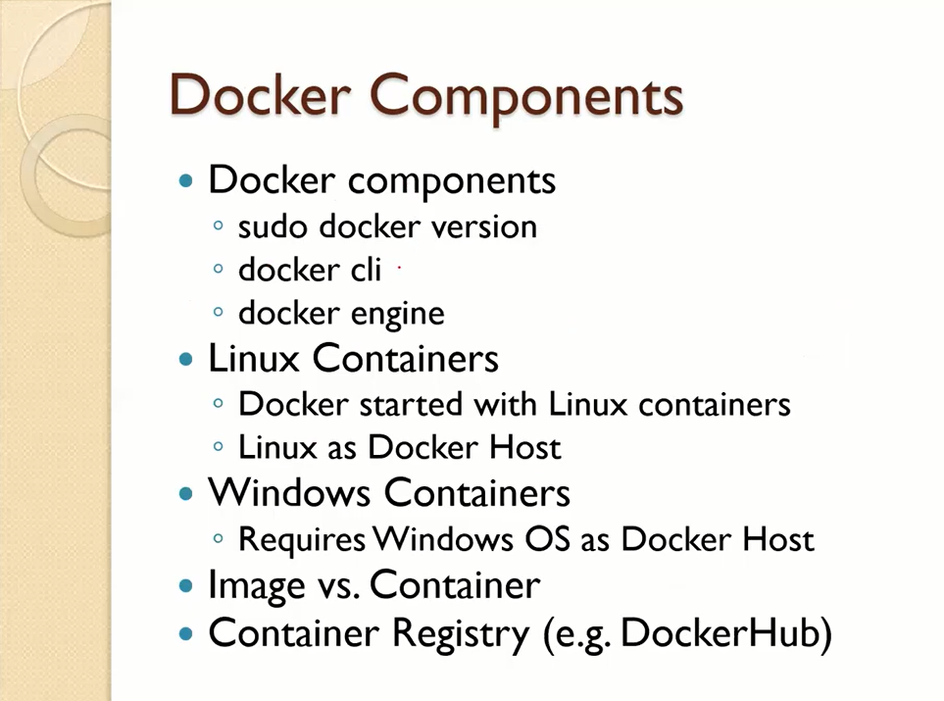

Slide 6
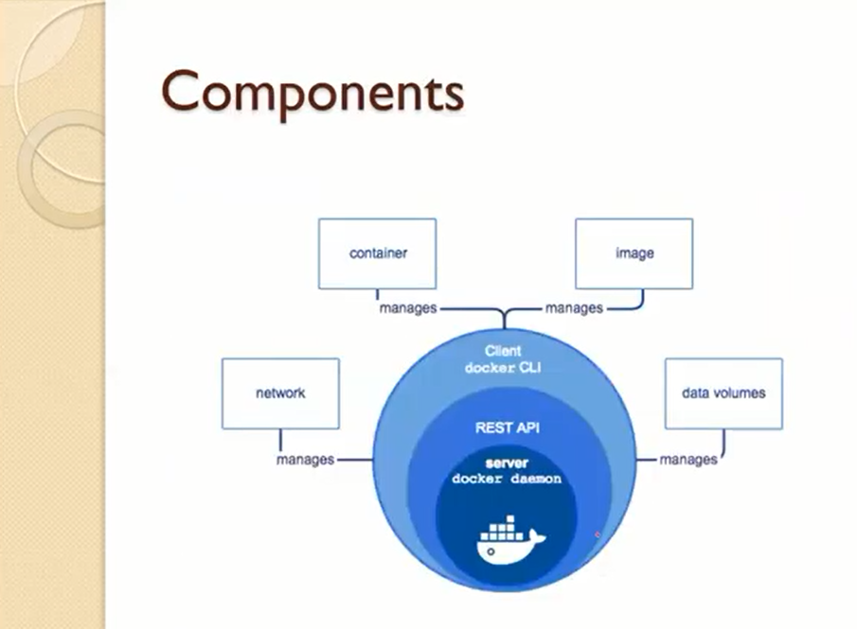

Slide 7
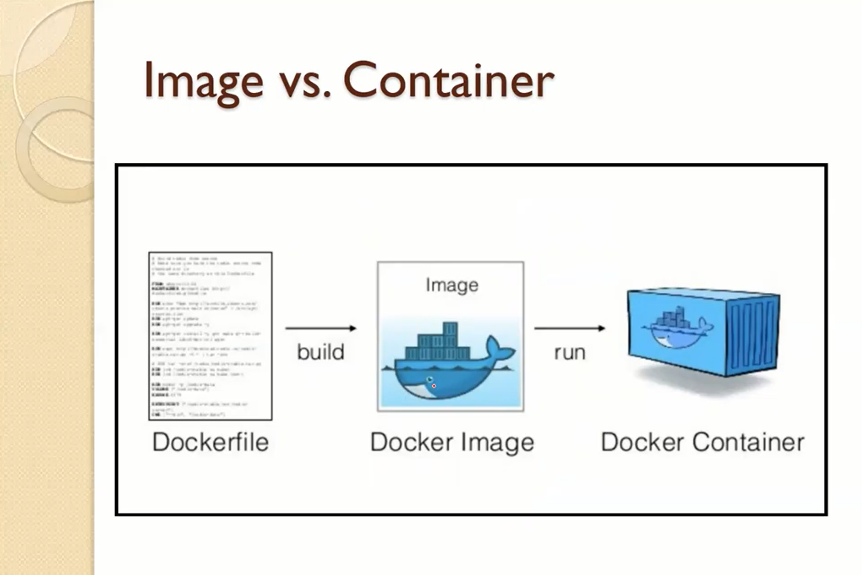

Slide 8
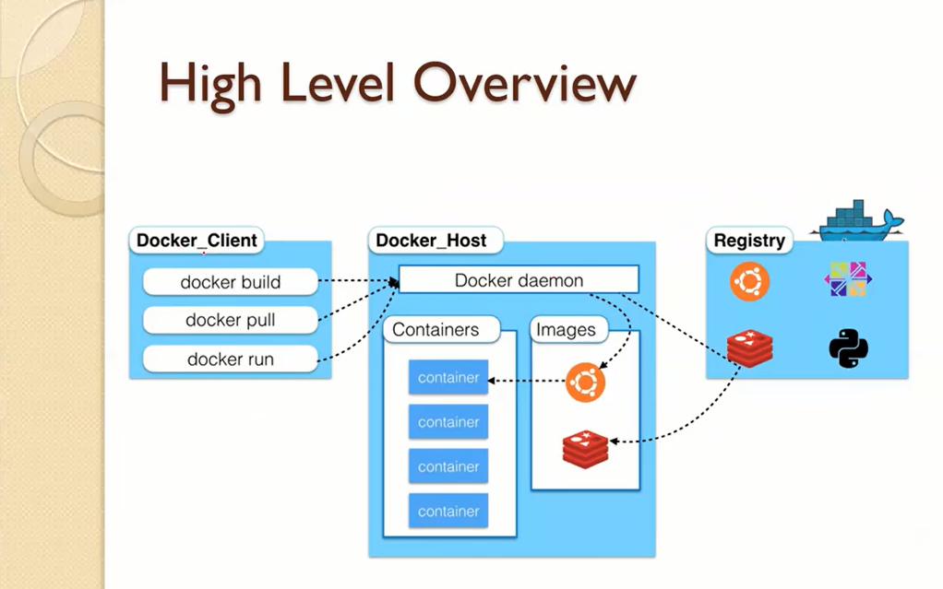

Slide 9
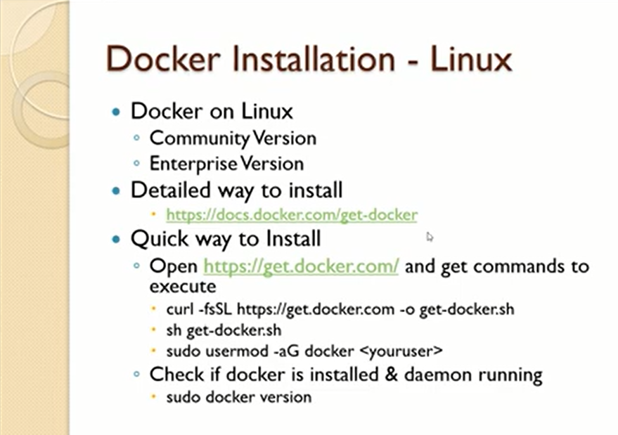

Slide 10
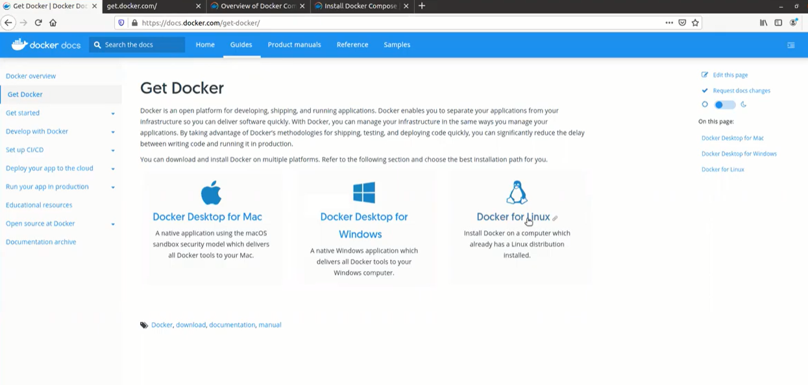
Detailed Way to install Docker

Slide 11
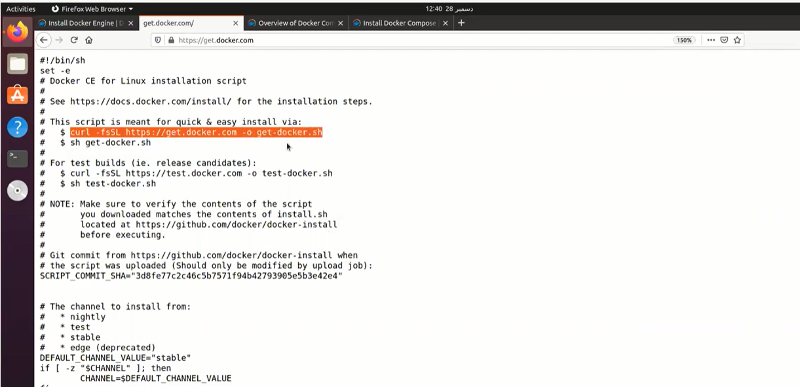
Quick Way to install Docker Copy the below selected command and run this by using terminal. Now copy the next line under the selected text and run.

Slide 12
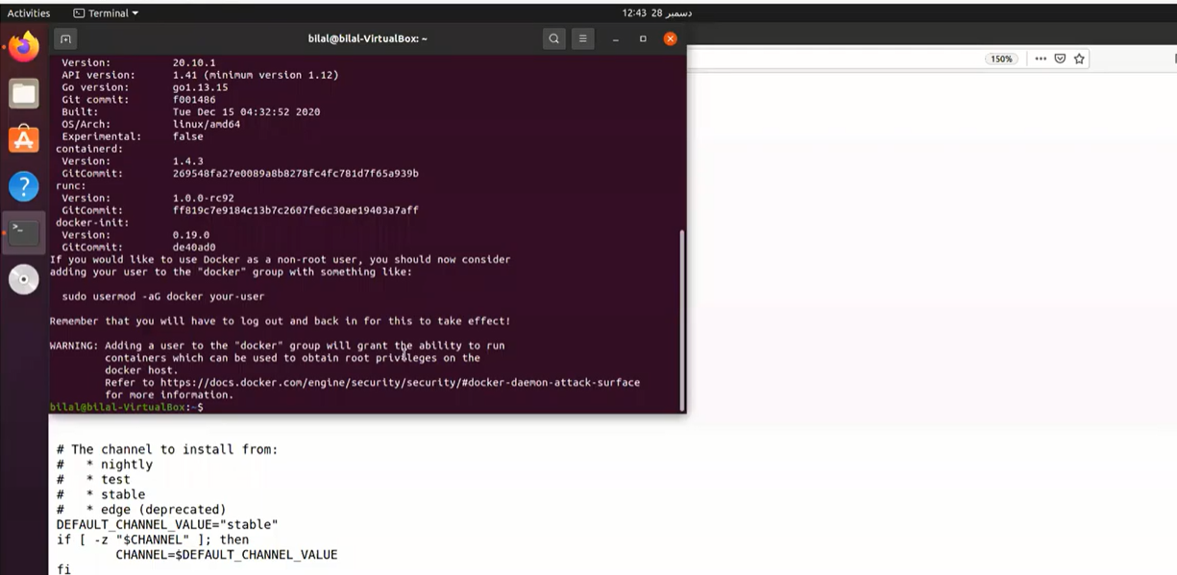
Installation in progress. It will take some time.

Slide 13
We need some high level privileges so therefore we add the user by using below command. sudo usermode –aG docker fahad If we want to check that the Docker is successfully installed on our machine, so type the below command sudo docker version

Slide 14
Now we are going to install the Docker compose utility. It will support us to run multi containers.

Slide 15
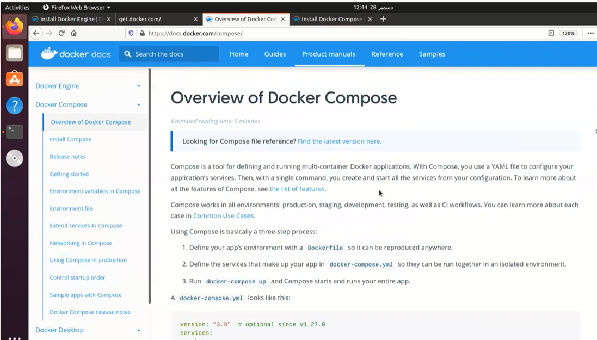
Open the link → https://docs.docker.com/compse/install

Slide 16
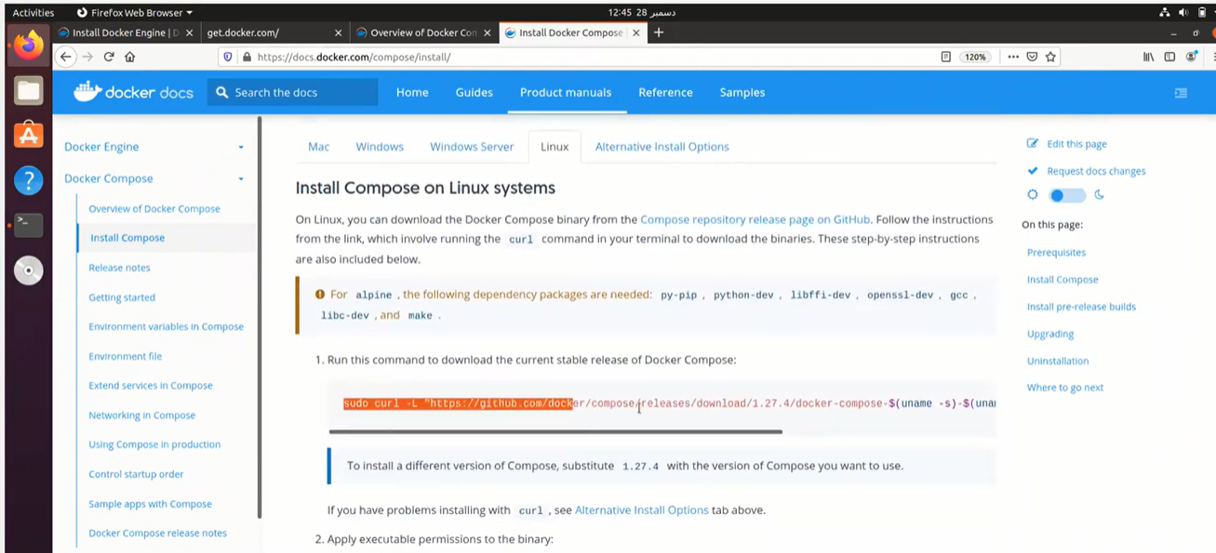
Open the Linux based installation. Copy the selected command and run it in terminal

Slide 17
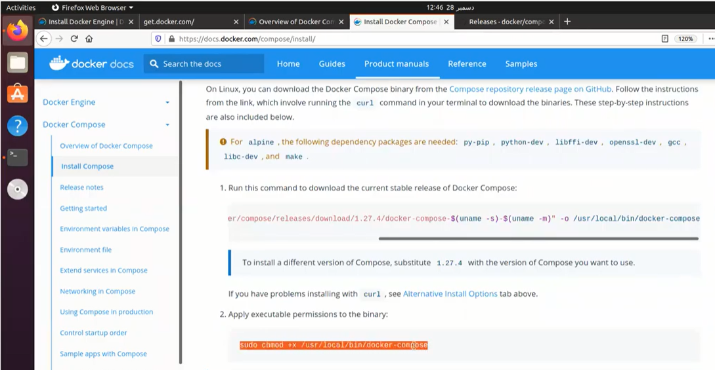
Set the permission Copy the selected command and run it in terminal

Slide 18
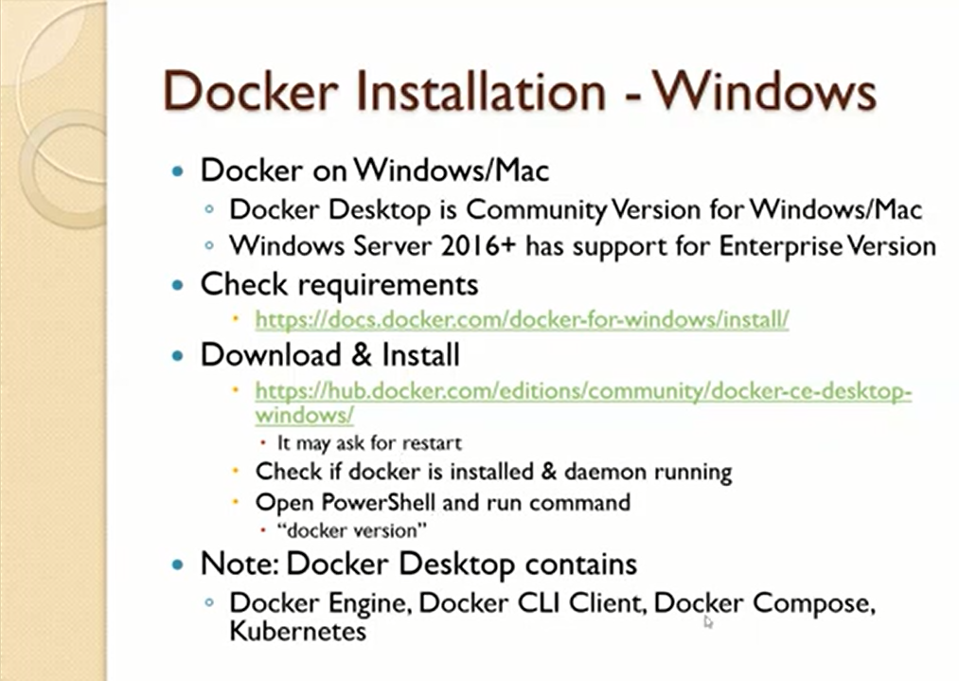
Task You all are required to install Docker for Windows base System.

